Slide 1
Leverage an LLM to dynamically generate API calls based on freeform text
Tural Mehtiyev
12/11/2023

Slide 2
Presentation Outline
Brief information about Large Language Models (LLMs);
What is Function Calling and Why it is useful?
Use case for Function Calling
Experiment Design
Implementation overview and results

Slide 3
The rapid evolution of Large Language Models (LLM)
… | 2017 | 2018 | 2019 | 2020 | 2021 | 2022 | 2023
Attention Transformer |  | BERT 340M | GPT2 1.5B | GPT3 175B | LaMDA (Bard) 173B | ChatGPT | GPT-4 (1.8T) MiniGPT-4
MT-NLG | PaLM 540B | LLaMA 1 7-65B LLaMA 2 7-70B
(Megatron- | BLOOM 175B | PaLM (up to 340B)
Turing) 530B | Flan 20B
 | YaLM 100B
GPT1 117M

Slide 4
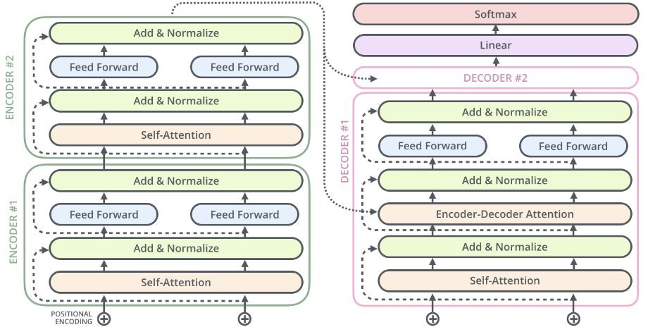
Transformer Architecture (encoder-decoder)
Decoder
Encoder
Feed forward
Feed forward
Encoder-Decoder Attention
Self-Attention
Self-Attention

Slide 5
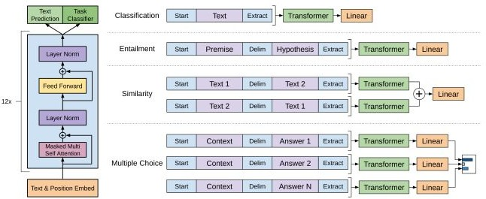
GPT-1
Decoder-Only
Unsupervised Pretraining on a text corpus
Supervised
Fine-tuning tasks on
Classification, Entailment, Similarity and Multiple Choice
Radford, A., et al., (2017) Improving Language Understanding by Generative Pre-Training

Slide 6
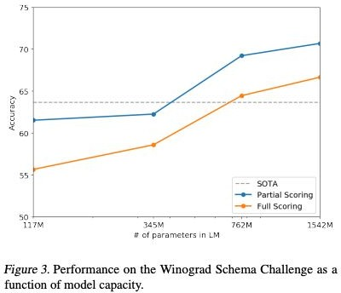
GPT-2
Winograd Example
The city councilmen refused the demonstrators a permit because they [feared/advocated] violence.
If the word is ``feared'', then ``they'' presumably refers to the city council; if it is ``advocated'' then ``they'' presumably refers to the demonstrators.
Incremental advancement to GPT
Introduced WebText dataset - filtered webscape 8M documents and 40GB text
GPT Decoder Transformer
Layer Norm Input to each Transformer Block
Additional Layer Norm to the output of the final Self-Attention Block
Larger vocabulary: 50k
Input context from 512 to 1,024
With 48 Transformer Layers, model size is 1.5B params
Zero-shot SOTA on several language tasks
Radford, A., et al., (2019) Language Models are Unsupervised Multitask Learners

Slide 7
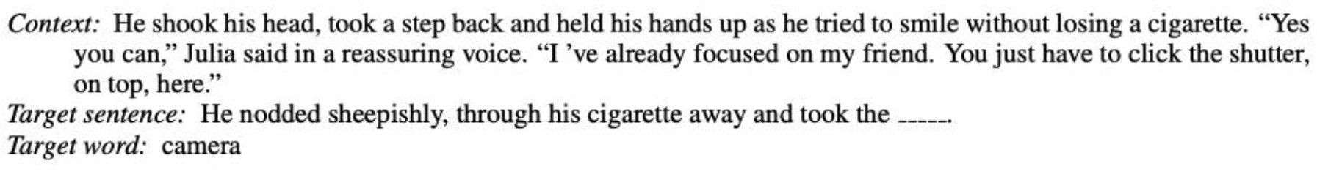
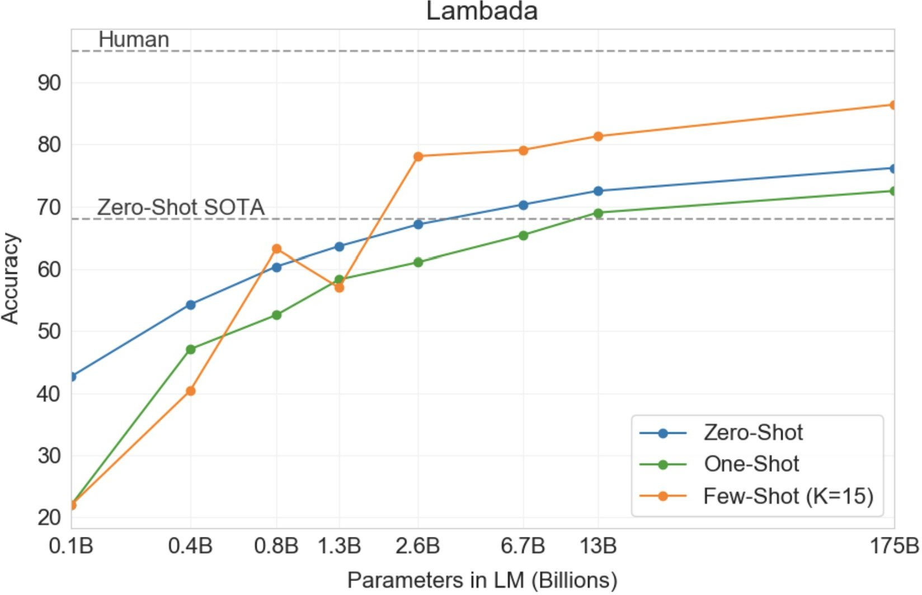
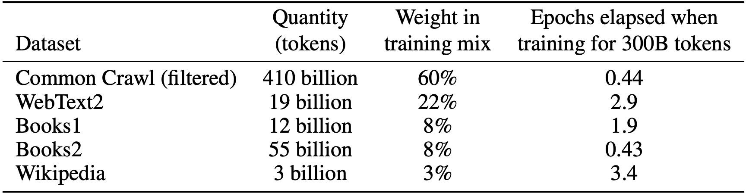
GPT-3
Demonstrated SOTA performance in few-shot, one-shot, and zero-shot learning
Architecture same as GPT-2, except GPT-3 transformer use alternating dense and locally banded sparse attention patterns
8 Models trained ranging from 125M - 125B params, and a context length of 2,048
Significantly larger training corpus
Considers effects of misinformation; evaluates bias in race, gender and religion and broader societal impacts
Brown. T., et al., (2020) Language Models are Few-Shot Learners

Slide 8

GPT-4 (Unofficial Info)
Model architecture is not officially published
GPT-4 has ~1.8 trillion parameters across 120 layers
10 times larger than GPT-3
Ensemble of experts
Fine-tuned using RLHF (official)
Dataset
~13T tokens, including both text-based and code-based data, with some fine-tuning data from ScaleAI and internally.
Included CommonCrawl & RefinedWeb, totaling 13T tokens. Speculation suggests additional sources like Twitter, Reddit, YouTube, and a large collection of textbooks.
The Decoder: GPT-4 architecture, datasets, costs and more leaked https://the-decoder.com/gpt-4-architecture-datasets-costs-and-more-leaked/

Slide 9
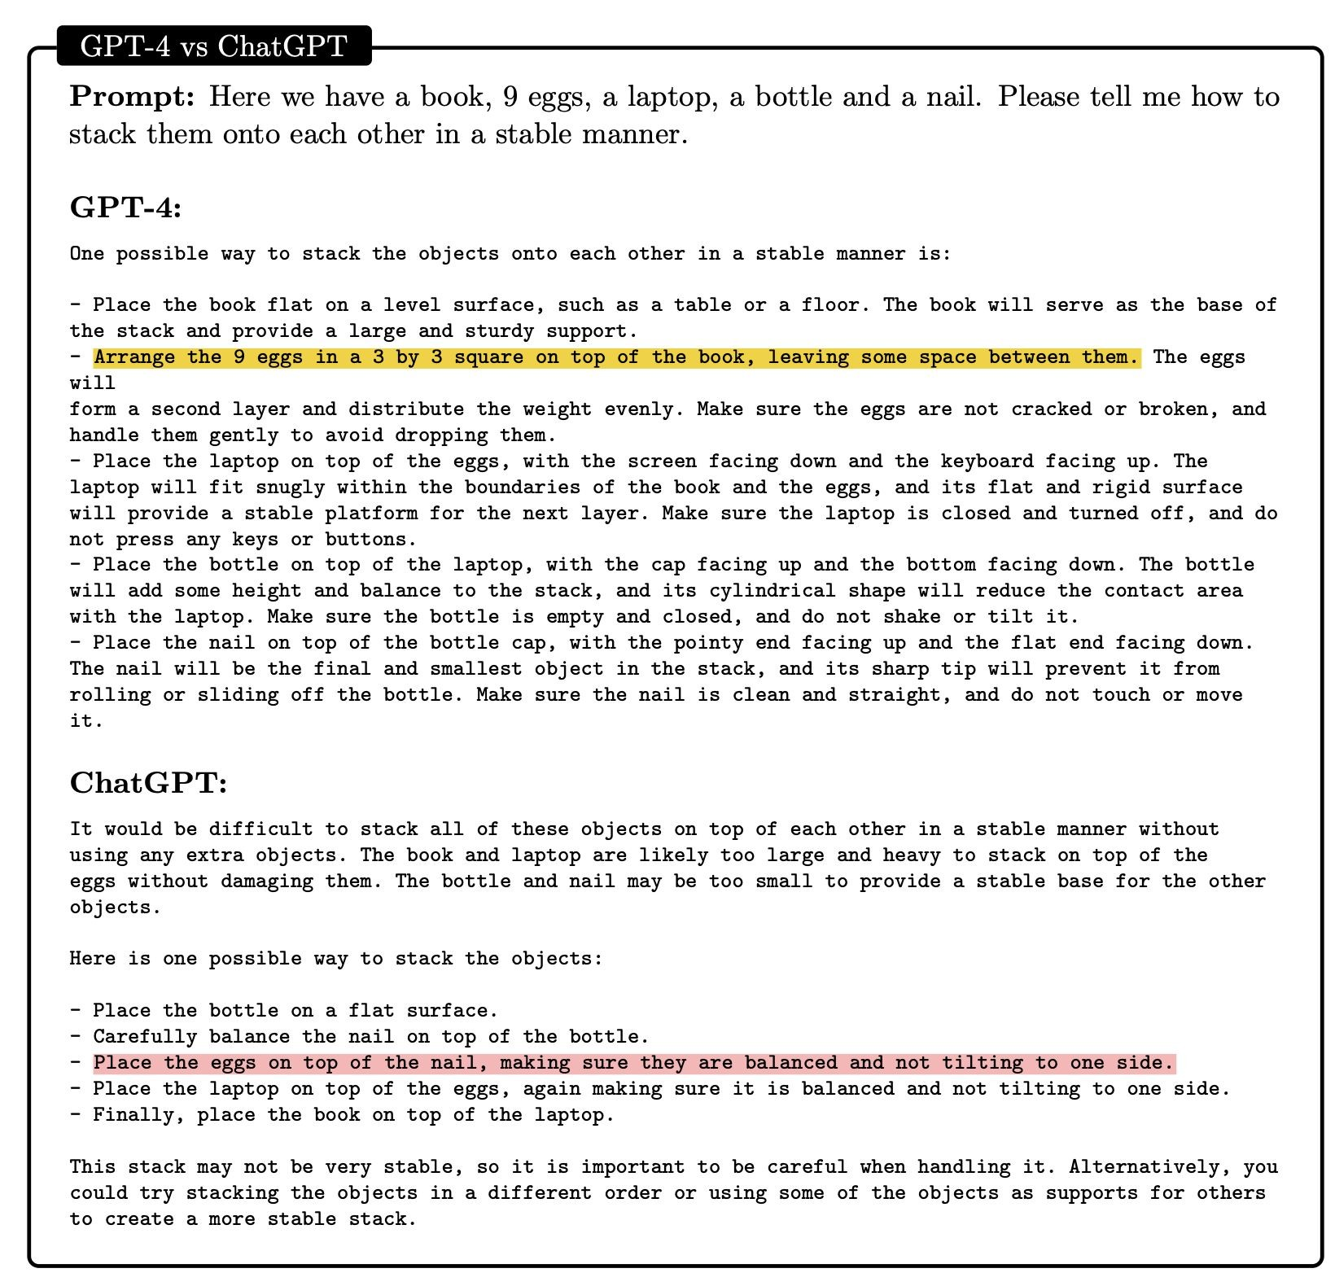
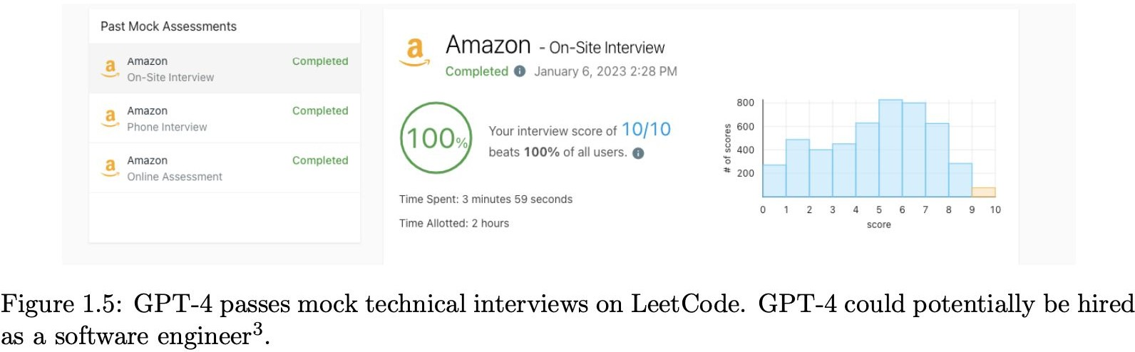
GPT-4 Performance
Solves novel and difficult tasks that span mathematics, coding, vision, medicine, law, psychology and more, without needing any special prompting
Microsoft Research, (2023) Sparks of Artificial General Intelligence: Early experiments with GPT-4

Slide 10
What is Function Calling in LLMs and Why it is useful?
Function calling in LLMs like GPT-3.5 and GPT-4 refers to the ability to execute user-defined functions within the natural language processing framework.
This capability allows the model to understand and act on specific prompts that resemble function-like instructions to return structured data.
Function calling in LLMs like GPT-3.5 and GPT-4 refers to the ability to execute user-defined functions within the natural language processing framework.
This capability allows the model to understand and act on specific prompts that resemble function-like instructions to return structured data.
"Why is function calling necessary? Are there alternative solutions?"

Slide 11
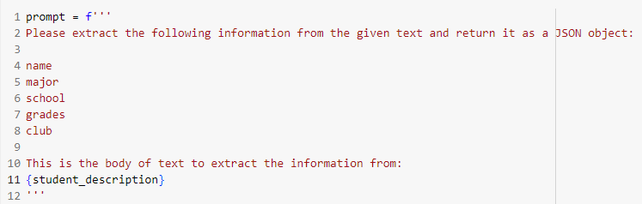
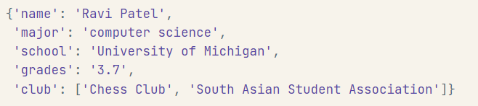
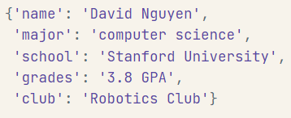
Not Effective Alternative
Input 1
Input 2
"Ravi Patel is a sophomore majoring in computer science at the University of Michigan. He is South Asian Indian American and has a 3.7 GPA. Ravi is an active member of the university's Chess Club and the South Asian Student Association. He hopes to pursue a career in software engineering after graduating."
"Ravi Patel is a sophomore majoring in computer science at the University of Michigan. He is South Asian Indian American and has a 3.7 GPA. Ravi is an active member of the university's Chess Club and the South Asian Student Association. He hopes to pursue a career in software engineering after graduating."
What is difference?
Note: Responses were generated by gpt-3.5-turbo

Slide 12
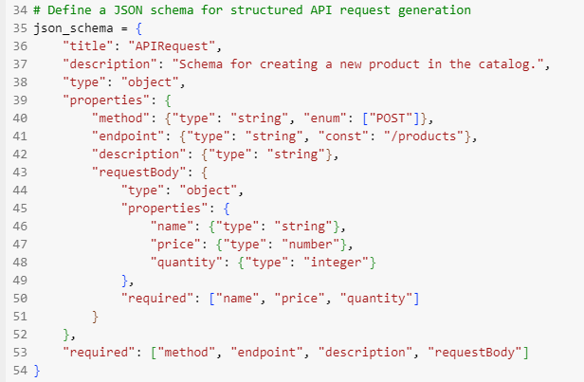
Function Calling Benefits
Benefits of Function Calling:
Structured Outputs: Converts free-form text into organized formats like JSON, making it easier to integrate with existing databases and applications.
Reduced Post-Processing: Minimizes the need for regular expressions or additional parsing to interpret the model's output.
Enhanced Developer Experience: Streamlines the workflow for developers by allowing direct use of familiar structures and data types.

Slide 13
Experiment Design
Experiment Design
API Schema Selection
Develop a JSON schema for API requests.
Focus on product catalog creation.
Schema includes method, endpoint, description, requestBody.
LLM Selection
Use three OpenAI LLMs:
GPT-3.5-Turbo
GPT-4
GPT-4-Turbo.
Function Calling Design
Data Generation and Collection
Create structured output with JSON schema.
Ensure consistent API request format using langchain.
Generate text prompts with "text-davinci-003".
Collect data via 100 iterations across LLMs.
Store outputs in DataFrame for analysis.
Evaluation and Results
Measure inconsistency rate across LLM outputs.
Categorize inconsistencies for in-depth analysis.
Identify trends and error rates among LLM versions.
Documentations of steps
https://github.com/tmehtiyev2019/llm-api-tm/blob/main/README.md

Slide 14
Results
Evaluated 100 outputs from GPT-3.5-Turbo, GPT-4, and GPT-4-Turbo, with 43% showing inconsistencies across 3 LLMs.
Inconsistency Category | Description | Instances
1 | Tricky Input Handling | 8%
2 | Significant Inconsistency | 9%
3 | Slight Inconsistency | 26%
LLM Version | Error Rate
GPT-4-Turbo | Lowest
GPT-4 | Medium
GPT-3.5-Turbo | Highest
GPT-4-Turbo demonstrated the lowest significant error rate.
Trends in error rates are consistent with the expected progress in LLM technology.
Categories 1 and 3 indicate less critical inconsistencies, whereas Category 2 reflects significant ones impacting system stability.
In-depth analysis of inconsistencies and their implications is available in the full report or in the GitHub repo given
https://github.com/tmehtiyev2019/llm-api-tm/blob/main

Slide 15
Thank you!

